Slide 1
Supply Chain Fast Reports
Dataset: SCM Shipment Historic

Slide 2
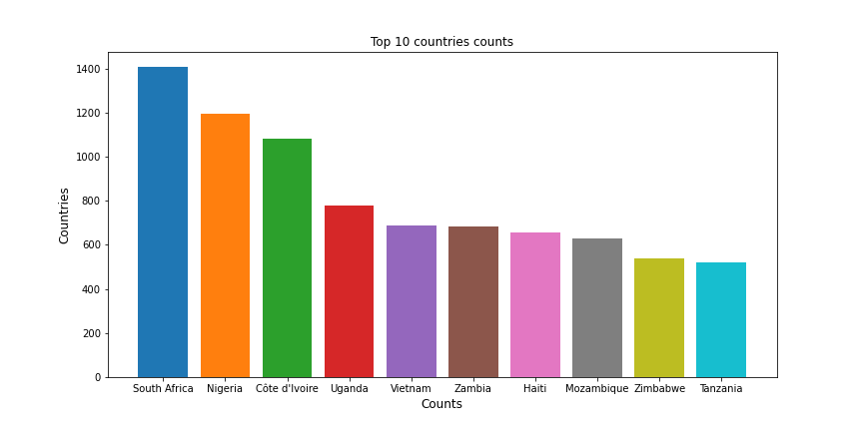
SCM Shipment Overall Analysis
Exploratory Analysis
• Country with most SKUs requests:South Africa (1406)
• Country with largest revenue with pack delivery: Nigeria ($25620.72)

Slide 3
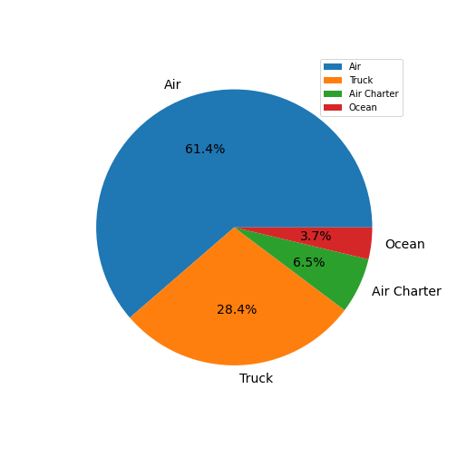
SCM Shipment Most Used Type
Shipment type analysis
• Most used transportation type: Air
• Shipment types: ['Air', 'Truck', 'Air Charter', 'Ocean']
• Pack price of the top 1 country: $25620.72
Most Delivered Products in the Week

Slide 4
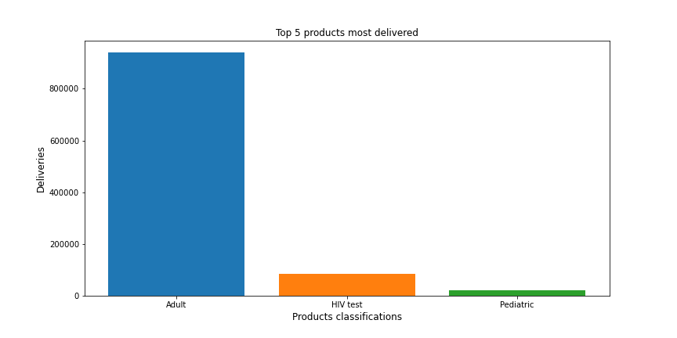
Fast Report
Week Report:
• Total freight cost: $703524.62
• Total weight transported: 1479166.0Kg
• Total revenue in the week: $11345276.48

